Slide 1
STRUCTURES
We’ve seen variables of simple data types, such as float, char, and int. Variables of such types represent one item of information: a height, an amount, a count, and so on.
But just as groceries are organized into bags, employees into departments, and words into sentences, it’s often convenient to organize simple variables into more complex entities.
The C++ construction called the structure is one way to do this.
A structure is a collection of simple variables. The variables in a structure can be of different types: Some can be int, some can be float, and so on. (This is unlike the array, which we’ll meet later, in which all the variables must be the same type.)
The data items in a structure are called the members of the structure.
However, for C++ programmers, structures are one of the two important building blocks in the understanding of objects and classes. In fact, the syntax of a structure is almost identical to that of a class.
A structure (as typically used) is a collection of data, while a class is a collection of both data and functions.

Slide 2
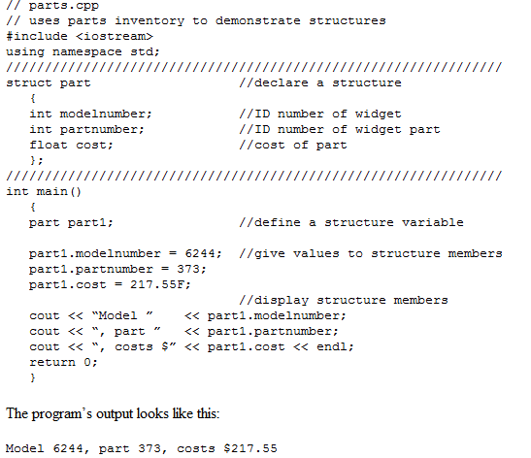
Let’s start off with a structure that contains three variables: two integers and a floating-point number. This structure represents an item in a any company’s parts inventory

Slide 3
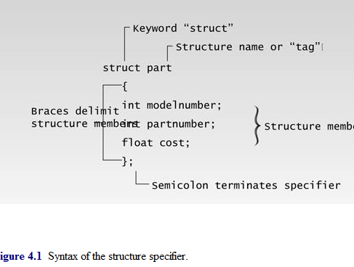
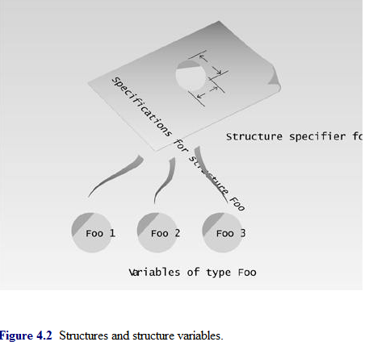

Slide 4
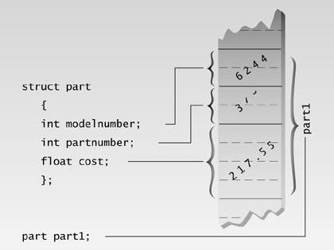
Defining a Structure Variable
The first statement in main(),
Part part1;
defines a variable, called part1, of type structure part. This definition reserves space in memory for part1.
How much space?
Enough to hold all the members of part1—namely modelnumber, partnumber, and cost.
In this case there will be 4 bytes for each of the two ints (assuming a 32-bit system), and 4 bytes for the float

Slide 5
Accessing Structure Members
Once a structure variable has been defined, its members can be accessed using something called the dot operator. Here’s how the first member is given a value:
part1.modelnumber = 6244;
The structure member is written in three parts: the name of the structure variable (part1); the dot operator, which consists of a period (.); and the member name (modelnumber).
This means “the modelnumber member of part1.” The real name of the dot operator is member access operator, but of course no one wants to use such a lengthy term.
Structure members are treated just like other variables. In the statement part1.modelnumber = 6244;, the member is given the value 6244 using a normal assignment operator. The program also shows members used in cout statements such as:
cout << “\nModel ” << part1.modelnumber;

Slide 6
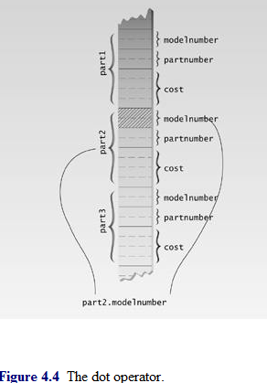

Slide 7
part part1;
Instead, the variable name part1 is placed at the end of the declaration:
struct
{
int modelnumber;
int partnumber;
float cost;
} part1;

Slide 8
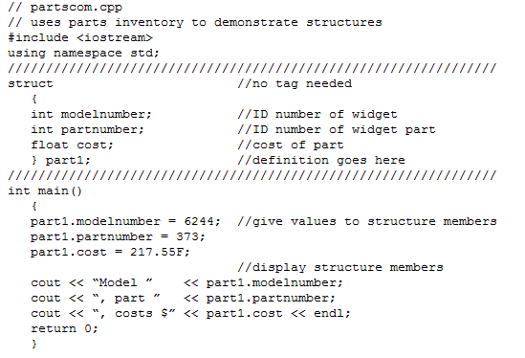

Slide 9
Initializing Structure Variables
The part1 structure variable’s members are initialized when the variable is defined:
part part1 = { 6244, 373, 217.55 };
The values to be assigned to the structure members are surrounded by braces and separated by commas. The first value in the list is assigned to the first member, the second to the second member, and so on.
Structure Variables in Assignment Statements
As can be seen in PARTINIT, one structure variable can be assigned to another:
part2 = part1;
The value of each member of part1 is assigned to the corresponding member of part1. Since a large structure can have dozens of members, such an assignment statement can require the computer to do a considerable amount of work.
Note that one structure variable can be assigned to another only when they are of the same structure type. If you try to assign a variable of one structure type to a variable of another type, the compiler will complain.

Slide 10
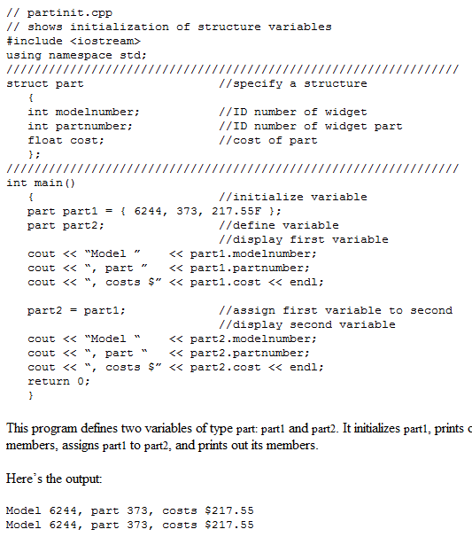

Slide 11
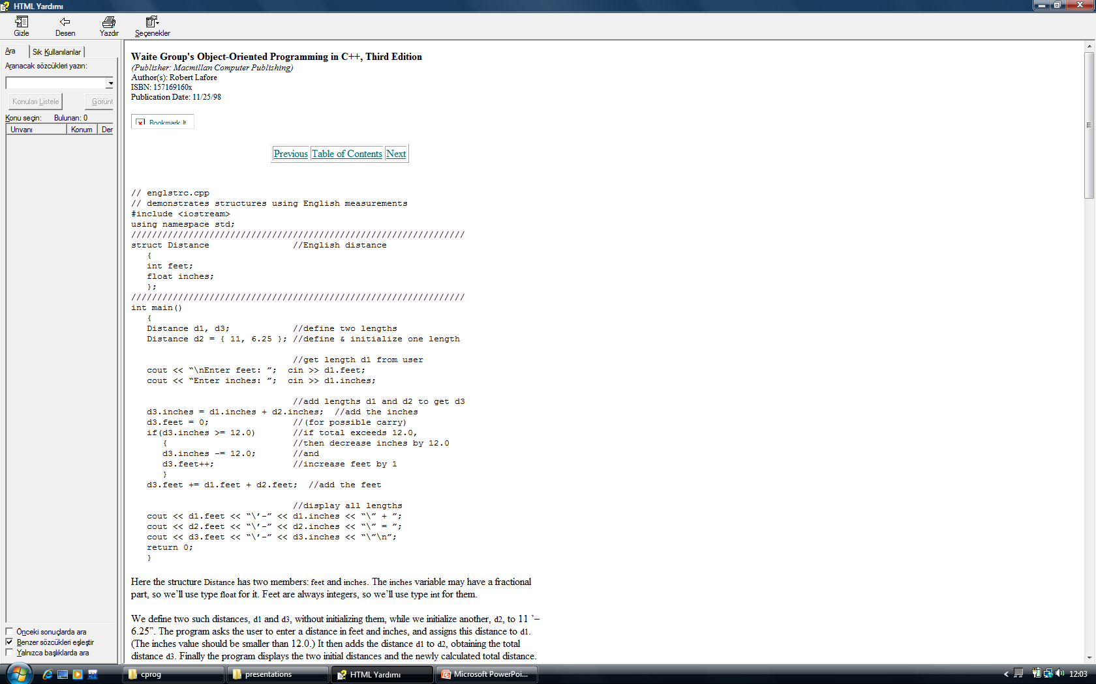
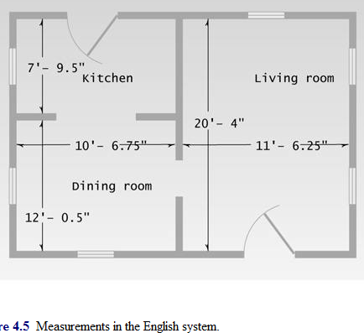

Slide 12
Structures Within Structures
You can nest structures within other structures. Here’s a variation on the ENGLSTRC program that shows how this looks. In this program we want to create a data structure that stores the dimensions of a typical room: its length and width.
Since we’re working with English distances, we’ll use two variables of type Distance as the length and width variables.
struct Room
{
Distance length;
Distance width;
}

Slide 13
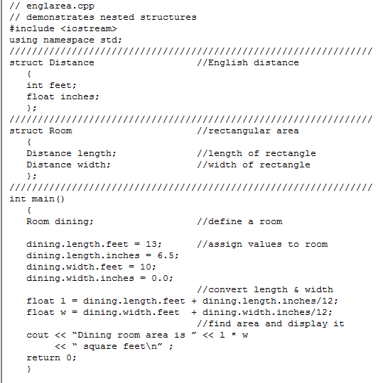

Slide 14
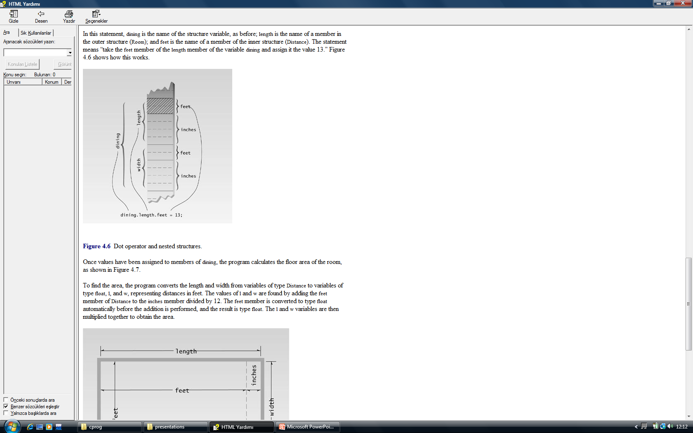
Accessing Nested Structure Members
Because one structure is nested inside another, we must apply the dot operator twice to access the structure members.
dining.length.feet = 13;

Slide 15
Initializing Nested Structures
How do you initialize a structure variable that itself contains structures? The following statement initializes the variable dining to the same values it is given in the ENGLAREA program:
Room dining = { {13, 6.5}, {10, 0.0} };
Each structure of type Distance, which is embedded in Room, is initialized separately. Remember that this involves surrounding the values with braces and separating them with commas. The first Distance is initialized to
{13, 6.5}
and the second to
{10, 0.0}
These two Distance values are then used to initialize the Room variable, again surrounding them with braces and separating them by commas.
Depth of Nesting
In theory, structures can be nested to any depth. In a program that designs apartment buildings, you might find yourself with statements like this one:
apartment1.laundry_room.washing_machine.width.feet

Slide 16
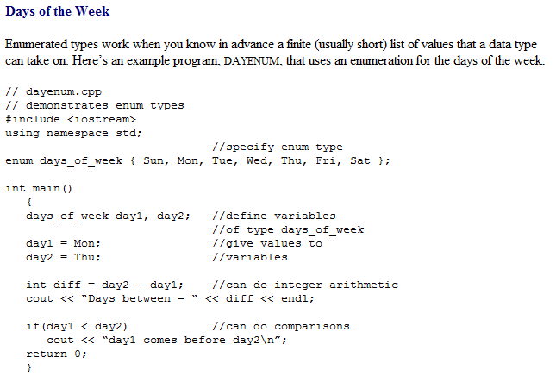
Enumerations
As we’ve seen, structures can be looked at as a way to provide user-defined data types. A different approach to defining your own data type is the enumeration. T
This feature of C++ is less crucial than structures. You can write perfectly good object-oriented programs in C++ without knowing anything about enumerations. However, they are very much in the spirit of C++, in that, by allowing you to define your own data types, they can simplify and clarify your programming.

Slide 17
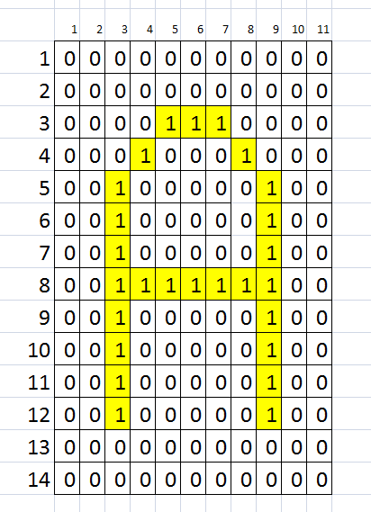

Slide 18
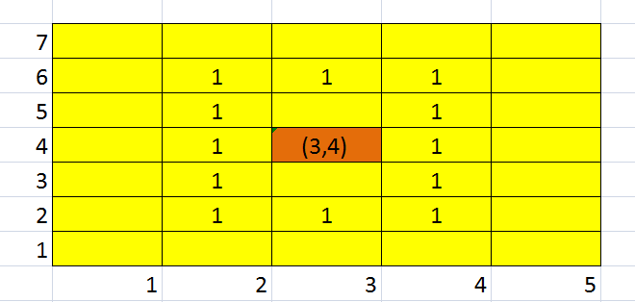
∑x = 2+2+2+3+4+5+6+6+6+5+4+3 =48
∑y = 2+3+4+4+4+4+4+3+2+2+2+2 =36
∑1 = 1+1+1+1+1+1+1+1+1+1+1+1=12
Ortalama x= ∑x/ ∑1=3
Ortalama y= ∑y/ ∑1=4

